Slide 1
Windows Server Security
ENCRYPTION AND APPLICATION CONTROL

Slide 2
Objectives
Learn about Application Security through Application Whitelisting
Learn about Encryption
Learn about AppLocker and BitLocker tools

Slide 3




















Windows Enterprise Security
Fundamentally Secure Platform
Securing Anywhere Access
Protect Users & Infrastructure
Protect Data from Unauthorized Viewing
User Account Control
Service Hardening
Manageability and Auditing
Network Security
Network Access Protection
DirectAccessTM
AppLockerTM
Internet Explorer 8
Data Recovery
RMS
EFS
BitLockerTM

Slide 4
Encryption
Encryption is the process of converting data into a format that cannot be read by another user.
Once a user has encrypted a file, it automatically remains encrypted when the file is stored on disk.
Decryption is the process of converting data from encrypted format back to its original format.
A key, which can be thought of as a password, is applied mathematical to plain text to provide cipher or encrypted text.

Slide 5
Cryptography System - Terminology
Cryptography
Plain text
Cipher text
Encryption
Decryption
Symmetric Cryptographic Algorithm
Asymmetric Keys
Public Key (Asymmetric) encryption
Public Key (Asymmetric) Cryptographic Algorithm
Public Key Infrastructure (PKI)
Notes:
Cryptography System – Terminology
Cryptography
Art and science of achieving security by encoding messages to make them non-readable
Plain text
Also called as clear text
Message that can be understood by the sender, the recipient and also anyone else who gets an access to the message
Cipher text
Codified plain text using any suitable scheme
Encryption
Process of transforming plain text to cipher text
Decryption
Process of transforming cipher text to plain text
Symmetric Cryptographic Algorithm
A cryptographic algorithm that uses the same key to encrypt plain text to cipher text and to decrypt cipher text to plain text
Asymmetric Keys
Two related keys, a public key and a private key, that are used to perform complementary operations, such as encryption and decryption or signature generation and signature verification.
Public Key Certificate
A digital document issued and digitally signed by the private key of a Certification Authority that binds the name of a subscriber to a public key. The certificate indicates that the subscriber identified in the certificate has sole control and access to the corresponding private key.
Public Key (Asymmetric) Cryptographic Algorithm
A cryptographic algorithm that uses two related keys, a public key and a private key. The two keys have the property that deriving the private key from the public key is computationally infeasible.
Public Key Infrastructure (PKI)
A set of policies, processes, server platforms, software and workstations used for the purpose of administering certificates and public-private key pairs, including the ability to issue, maintain, and revoke public key certificates.

Slide 6
Encrypting Files with BitLocker
When you use BitLocker on fixed and removable data drives that are not the OS volume, you can use one of these:
Password
Smart card
Automatic Unlock

Slide 7
Configuring BitLocker Encryption
Before you can use BitLocker on a server running Windows Server 2012, you must first install BitLocker using Server Manager.
You can then determine whether you have TPM and turn on BitLocker.

Slide 8
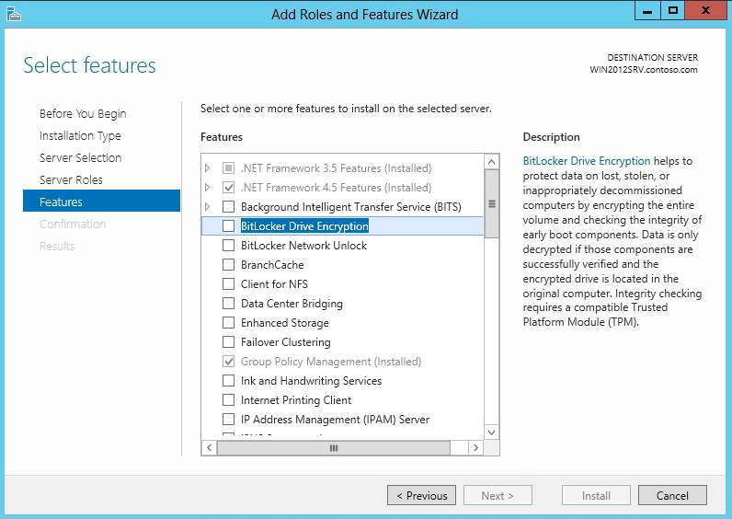
Install BitLocker
Using the Select Features page

Slide 9
Encryption and Decryption
Encryption
  Conversion of Plain Text to Cipher Text
Decryption
  Conversion of Cipher Text to Plain Text
Hello John
Ifmmp Kpio
Plain text
Encrypt
Cipher text
Ifmmp Kpio
Hello John
Cipher text
Decrypt
Plane text
Notes:
Cryptography System – Encryption and Decryption
Cryptography
Art and science of achieving security by encoding messages to make them non-readable
Plain text (Clear text)
Message that can be understood by the sender, the recipient and also anyone else who gets an access to the message
Cipher text
Codified plain text using any suitable scheme
Encryption
Process of transforming plain text to cipher text
Decryption
Process of transforming cipher text to plain text

Slide 10


Types of Cryptography
Symmetric key cryptography uses the same key for encryption and decryption
Asymmetric key cryptography uses different keys for encryption and decryption
Cryptography techniques
Symmetric key
cryptography
Asymmetric key cryptography

Slide 11
Symmetric Algorithms
International Data Encryption Algorithm (IDEA),
  Block cipher – 128-bit key
  Pretty Good Privacy (PGP)
Rivest Cipher 4 (RC4), Stream cipher
  Wireless Equivalent Privacy (WEP), Wi-Fi Protected Access (WPA) – Temporal Key Integrity Protocol (TKIP), Transport Layer Security (TLS)
RC5, Block cipher
  RSA products such as BSAFE, JSAFE and S/MAIL
Blowfish, Block cipher
  OpenSSH, PuTTy
Advanced Encryption Standard (AES)
  BitLocker, TrueCrypt, WPA2

Slide 12
Advanced Encryption Standard (AES)
Plaintext (128 bits)
AES
Key (128-256 bits)
Ciphertext (128 bits)
AES Demo in CryptTool educational software or at https://www.youtube.com/watch?v=mlzxpkdXP58
Notes:
Advanced Encryption Standard (AES)
DES become vulnerable as computing capability catch up - key size is too small. A stronger Triple-DES can be used, but it is slow with small block size
US NIST issued call for ciphers in 1997 to replace DES
15 candidates accepted in Jun 98
Five were shortlisted in Aug 99
MARS (IBM) - complex, fast, high security margin
RC6 (USA) - v. simple, v. fast, low security margin
Rijndael (Belgium) - clean, fast, good security margin
Rijndael was selected as the AES in Oct-2000
Serpent (Euro) - slow, clean, v. high security margin
Twofish (USA) - complex, v. fast, high security margin

Slide 13
BitLocker™ Drive Encryption
BitLocker™ Drive Encryption gives you improved data protection on your Windows
  Notebooks – Often stolen, easily lost in transit
  Desktops – Often stolen, difficult to safely decommission
  Servers – High value targets, often kept in insecure locations
  All three can contain very sensitive IP and customer data
Designed to provide a transparent user experience that requires little to no interaction on a protected system
Prevents thieves from using another OS or software hacking tool to break OS file and system protections
  Prevents offline viewing of user data and OS files
  Provides enhanced data protection and boot validation
  through use of a Trusted Platform Module (TPM)

Slide 14
BitLocker™ Drive Encryption Architecture
Static Root of Trust Measurement of boot components

Slide 15


Disk Layout And Key Storage
OS Volume Contains
Encrypted OS
Encrypted Page File
Encrypted Temp Files
Encrypted Data
Encrypted Hibernation File
Where’s the Encryption Key?
SRK (Storage Root Key)
contained in TPM
SRK encrypts FVEK (Full Volume Encryption Key) protected by TPM/PIN/USB Storage Device
FVEK stored (encrypted by SRK) on hard drive in the OS Volume
3
OS Volume
2
FVEK
1
SRK
System
System Volume Contains:
MBR, Boot manager, Boot Utilities
(Unencrypted, small)

Slide 16




Spectrum of Protection
Ease of Deployment / Maintenance
BitLocker™ offers a spectrum of protection, allowing an organization to customize according to its own needs
TPM Only
“What it is”
Protects Against:
Most SW attacks
Vulnerable To:
Hardware attacks
User Must:
N/A
No user impact
TPM + PIN
“What it is + what you know”
Protects Against:
Many HW attacks
Vulnerable To:
Hardware attacks
User Must:
Enter PIN to boot
TPM + USB
“What it is + what you have”
Protects Against:
HW attacks
Vulnerable To:
Stolen USB key
User Must:
Protect USB key
USB Only
“What you have”
Protects Against:
HW attacks
Vulnerable To:
Stolen USB key
No boot validation
User Must:
Protect USB key

Slide 17
Application Control
Application control is a security practice that blocks or restricts unauthorized applications from executing in ways that put data at risk

Slide 18
Application Control
Prevent all other, unauthorized applications from executing – they may be malicious, untrusted, or simply unwanted
Eliminate unknown and unwanted applications in your network to reduce IT complexity and application risk
Reduce the risks and costs associated with malware
Improve your overall network stability
Identify all applications running within the endpoint environment
Protect against exploits of unpatched OS and third-party application vulnerabilities

Slide 19
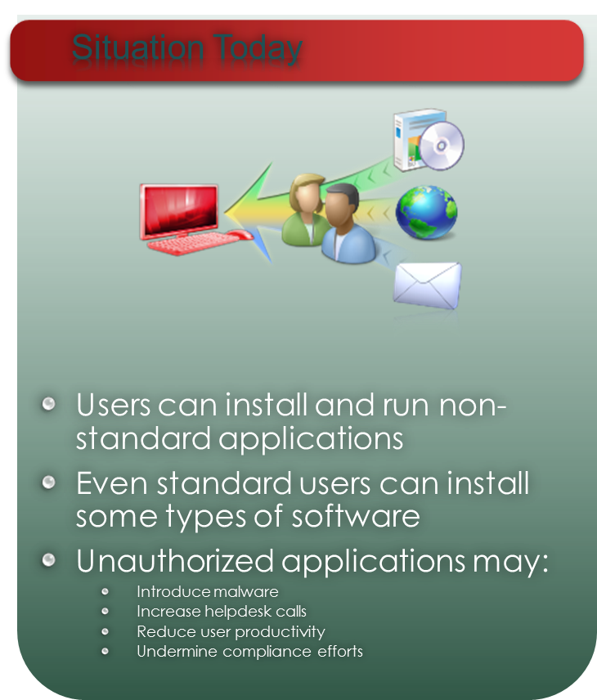
Application Control in Windows

Slide 20
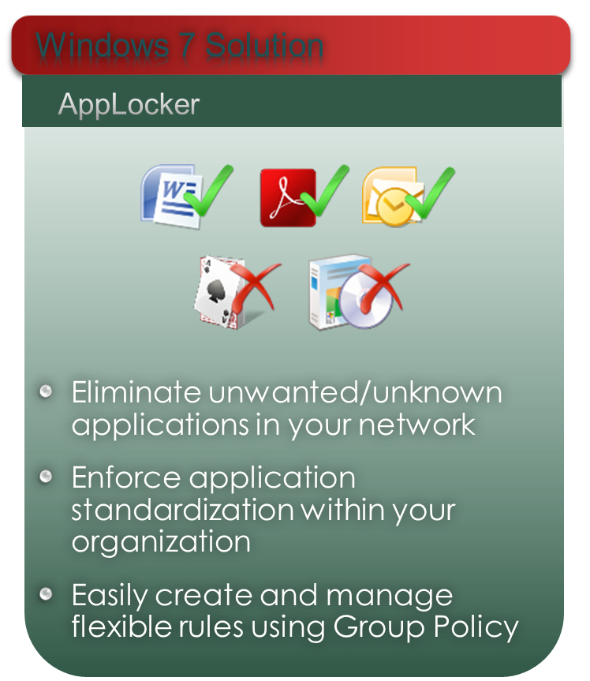
Application Control

Slide 21






AppLocker
Technical Details
  Simple Rule Structure: Allow, Exception & Deny
  Publisher Rules
    Product Publisher, Name, Filename & Version
  Multiple Policies
    Executables, installers, scripts & DLLs
  Rule creation tools & wizard
    Including PowerShell cmdlets
  Audit only mode
  SKU Availability
    AppLocker – Enterprise
    Legacy SRP – Business & Enterprise

Slide 22
AppLocker
A mandatory style policy for applications, scripts, installer and DLLs – useful for “White Listing”
Application Restriction Policy to prevent users from ( or allow) running certain types of applications
Option to exercise “audit” before enforcing
AppLocker rules include:
  Hash rules
  Path rules
  Publisher rules ( based on digital signature of original publisher of software)
AppLocker rules cannot be enforced on computers running Windows 7 Pro.

Slide 23
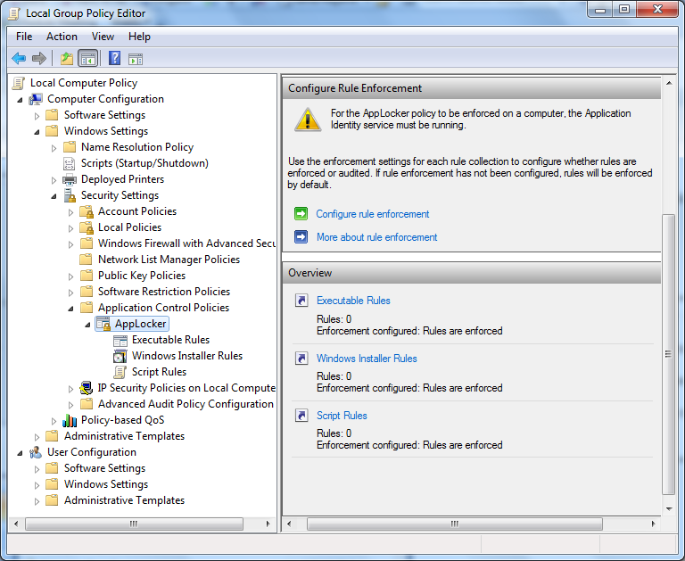
Accessing AppLocker

